Slide 1
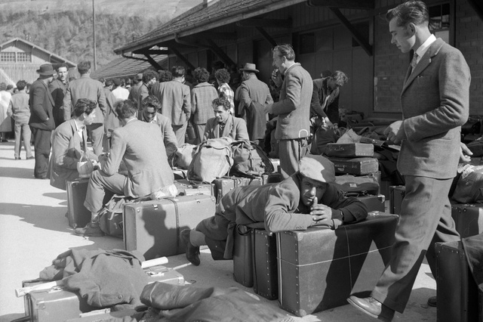
24.000.000

Slide 2
This is the Crucial Number to understand the size of the large and complex phenomenon which is the history of the Italian emigration. In fact Twenty-four million is an entity that repeates -as if by magic- to accompany the study and to characterize the reconstruction of the diaspora of the Italians in the world.
Ventiquattro milions.
24.000.000

Slide 3
In fact twenty-four million were the compatriots who left their homeland in the first century of the unified Italy. That is from 1861 to 1960.
24.000.000

Slide 4
The same number corresponds to the Italian population at the time of the unit. So, it is as if the entire population of the unified Italy in 1861 had left their nation.
24.000.000

Slide 5
Besides, Twenty-four million are the Italians who stood in a foreign land from the unification of Italy to nowadays. Excluding ten million of returned Italians, and ten million of persons who left the past five decades.
24.000.000

Slide 6
The resident abroad Italians , those that anyway have the Italian citizenship, are actually a quarter of these twenty-four million "settled" in the course of a century and a half, or about six million (half living in Europe).
24.000.000:4

Slide 7
But he omnipresent figure of twenty-four million can be safely multiplied by two, if we consider the people of Italian origin including the ORIUNDI.
24.000.000 x 2

Slide 8
Representing really "another Italy", particularly "visible" through urban concentrations, specialized businesses, associations, cultural presences ..
24.000.000 x 2

Slide 9
Italy has been affected by emigration, especially in the nineteenth (XIX) and twentieth (XX) centuries.

Slide 10
Since the 1820’s migration started but it was only at the beginning, and the transoceanic and permanent departures were a poor consistency phenomenon:

Slide 11
1820 -1850
6400 persons totally to the United States from 1820 to 1850;
8000 persons totally to Uruguay from 1835 to 1842.

Slide 12
Two very important periods:
GREAT MIGRATION BETWEEN THE END OF XIX CENTURY AND THE 30’S OF THE XX CENTURY THE AMERICAN EMIGRATION
THE 50 ‘S THE EUROPEAN EMIGRATION

Slide 13
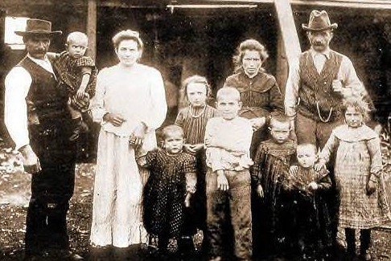
WHY?? Not yet industrialization, and the farming communities of north and south Italy were very poor.

Slide 14
-Europe: The main destinations were France, Swizzerland and Germany where miners and industy workers were needed. The main destinations over the oceans were countries with great unexploited lands and manpower needs: -South America( mostly Argentina and Brazil) -North America (United States).
THE GREAT MIGRATION

Slide 15
The industrial development of France has fostered a demand for workers from other states, more and more massive. Initially, the most affected area in this industrial expansion was Lorraine, even if the phenomenon, and consequently the presence of foreigners, has spread all over the national territory.
1850 -1890 in Europe:

Slide 16
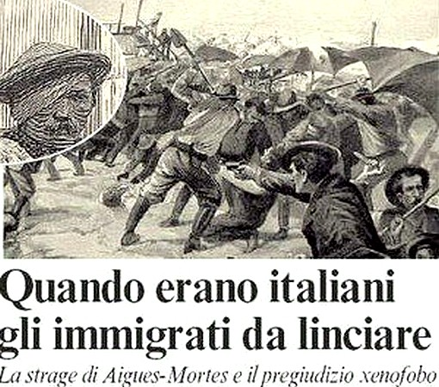
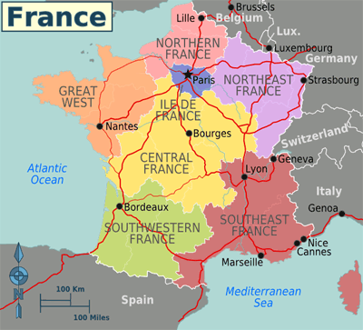
They came from all over Italy, but especially from the regions of Northern Italy. The French cities with the largest Italian communities were Paris, Lyon, Marseille, Nice and Grenoble

Slide 17
THE TRANSOCEANIC EMIGRATION
The most popular destinations:
United States
Argentina
Brazil

Slide 18
The departures to the countries over the Atlantic Ocean: -in 1880 about 109.000/ migrants a year; -in 1900 about 310.000/ migrants a year; -in 1913 about 873.000/ migrants a year. After the end of the First World War migration started again: in 1920-1927 about 615.000/ migrants a year; in 1927 the Fascist regime stopped the migration flow.
The Great MIGRATION to AMERICA

Slide 19
ITALIAN MIGRATION TO THE UNITED STATES PERIOD (1881 – 1920)
 | UNITED STATES | TOTAL ITALIAN MIGRANTS | %
1881 - 1890 | 244.870 | 1.879.200 | 13.00
1891 - 1900 | 514.330 | 2.834.730 | 18,18
1901 - 1910 | 2.329.450 | 6.026.690 | 38,60
1911 - 1920 | 1.566.780 | 3.828.070 | 40,92
TOT 1881 - 1920 | 4.655.430 | 14.568.690 | 31,65

Slide 20
ITALIAN MIGRATION TO BRAZIL AND ARGENTINA PERIOD (1881 – 1920)
 | BRAZIL | ARGENTINA | TOTAL ITALIAN MIGRANTS
1881 - 1890 | 291.630 | 391.970 | 1.879.200
1891 - 1900 | 580.220 | 367.220 | 2.834.730
1901 - 1910 | 303.360 | 734.600 | 6.026.690
1911 - 1920 | 125.880 | 315.520 | 3.828.070
TOT 1881 - 1920 | 1.311.090 | 1.809.310 | 14.568.690

Slide 21
ITALIAN MIGRATION PERIOD (1876 – 1976)
Italy | Number of Migrants | Region Coming from:
South | 10.000.000 | Sicilia/Calabria
Center | 5.000.000 | Campania/Abruzzo
North Est | 5.500.000 | Veneto
North West | 5.000.000 | Lombardia/Piemonte
 | 25.500.000

Slide 22
At the beginning, mostly of migrants worked on railroad construction works or other public works and for long time they were considerated at the lower level of the social ladder. Only many years later, after the Second World War, they were respected and valued. Will see the video….. .
The Italians in USA

Slide 23
Men resting
in a building Yard

Slide 24
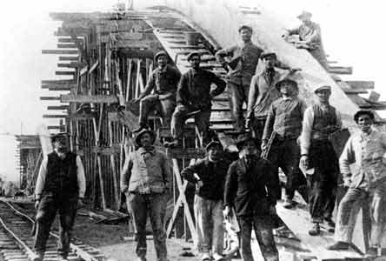
Workers in a railway Yard

Slide 25
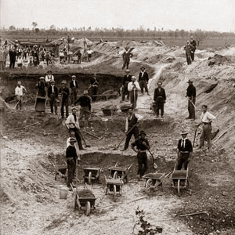
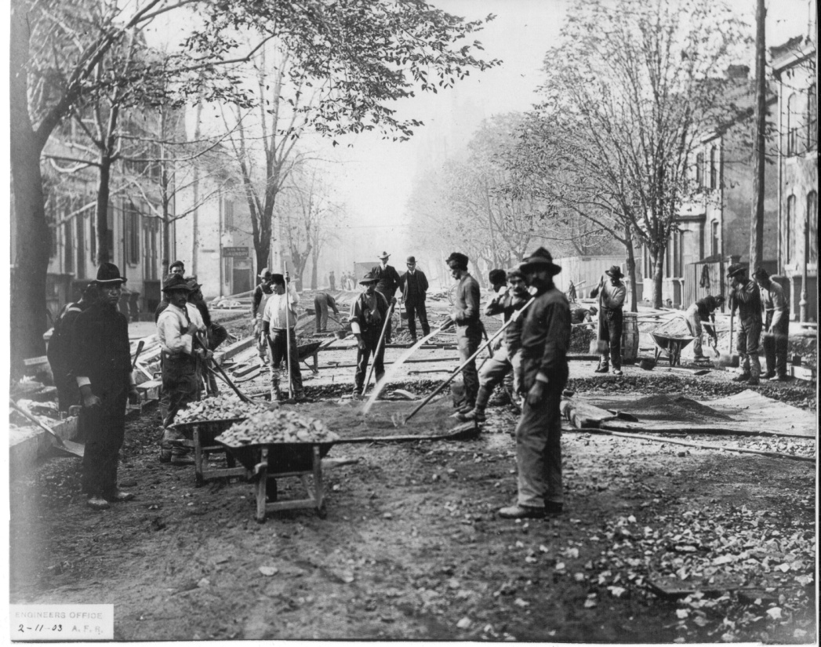
Workers in road contruction Yard

Slide 26
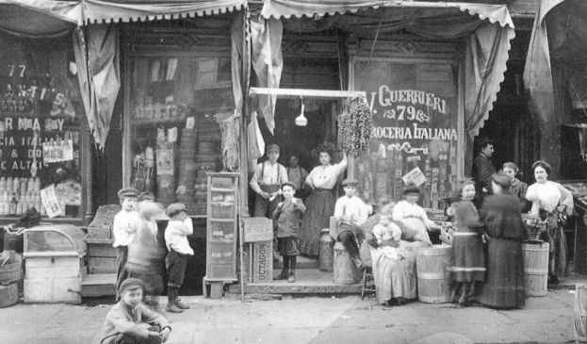
Italian merchant

Slide 27
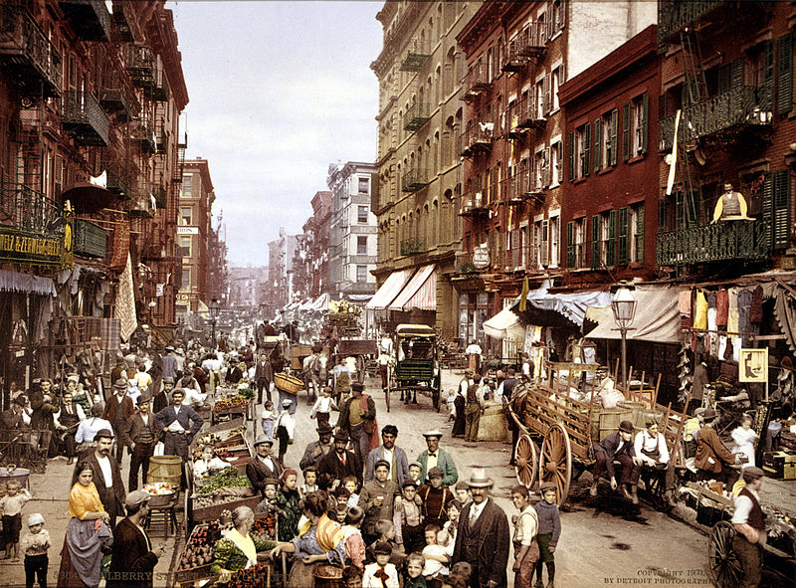
NEW YORK
LITTLE ITALY

Slide 28
Little Italy is a general name for an ethnic enclave populated primarily by Italians or people of Italian ancestry, usually in an urban neighborhood.
The concept of "Little Italy" holds many different aspects of the Italian culture. There are shops selling Italian goods as well as Italian restaurants lining the streets. A "Little Italy" strives essentially to have a version of the country of Italy placed in the middle of a big non-Italian city. This sort of enclave is often the result of periods of immigration in the past, during which people of the same culture settled together in certain areas. As cities modernized and grew, these areas became known for their ethnic associations, and towns like "Little Italy" blossomed, becoming the icons they are today.

Slide 29
Video:
Migration to America

Slide 30
The Italians to BRAZIL
The first flow of migrants they were mostly farmhand, coming from the Veneto region.
Since 1888 slavery had been abolished in Brazil, and a lot of Italian migrants found work very easily inside the “Fazendas”,
the typical Brasil large farms.
The Italians represented the most important group of immigrants, surpassing even the Portuguese one.
This is the oldest migration flow, and then the number of oriundi is now particularly high.
.

Slide 31
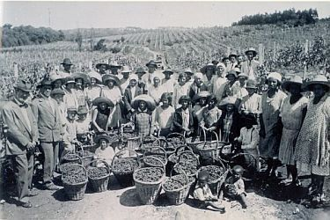
Italians working in the cafee plantations in the southern regions of San Paulo and Santa Catarina.

Slide 32
The Italians in ARGENTINA
According to estimates, about 3 million people left Italy from Argentina between 1876 and 1976, with maximum flow between 1905 and 1914.

Slide 33
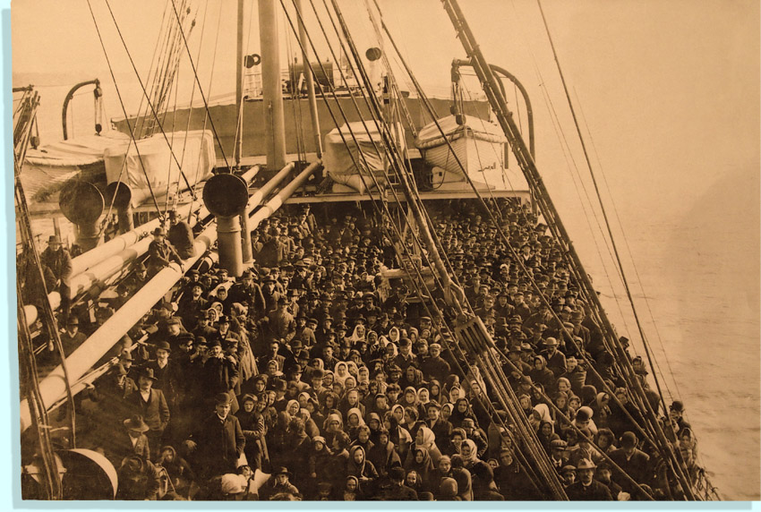

Slide 34
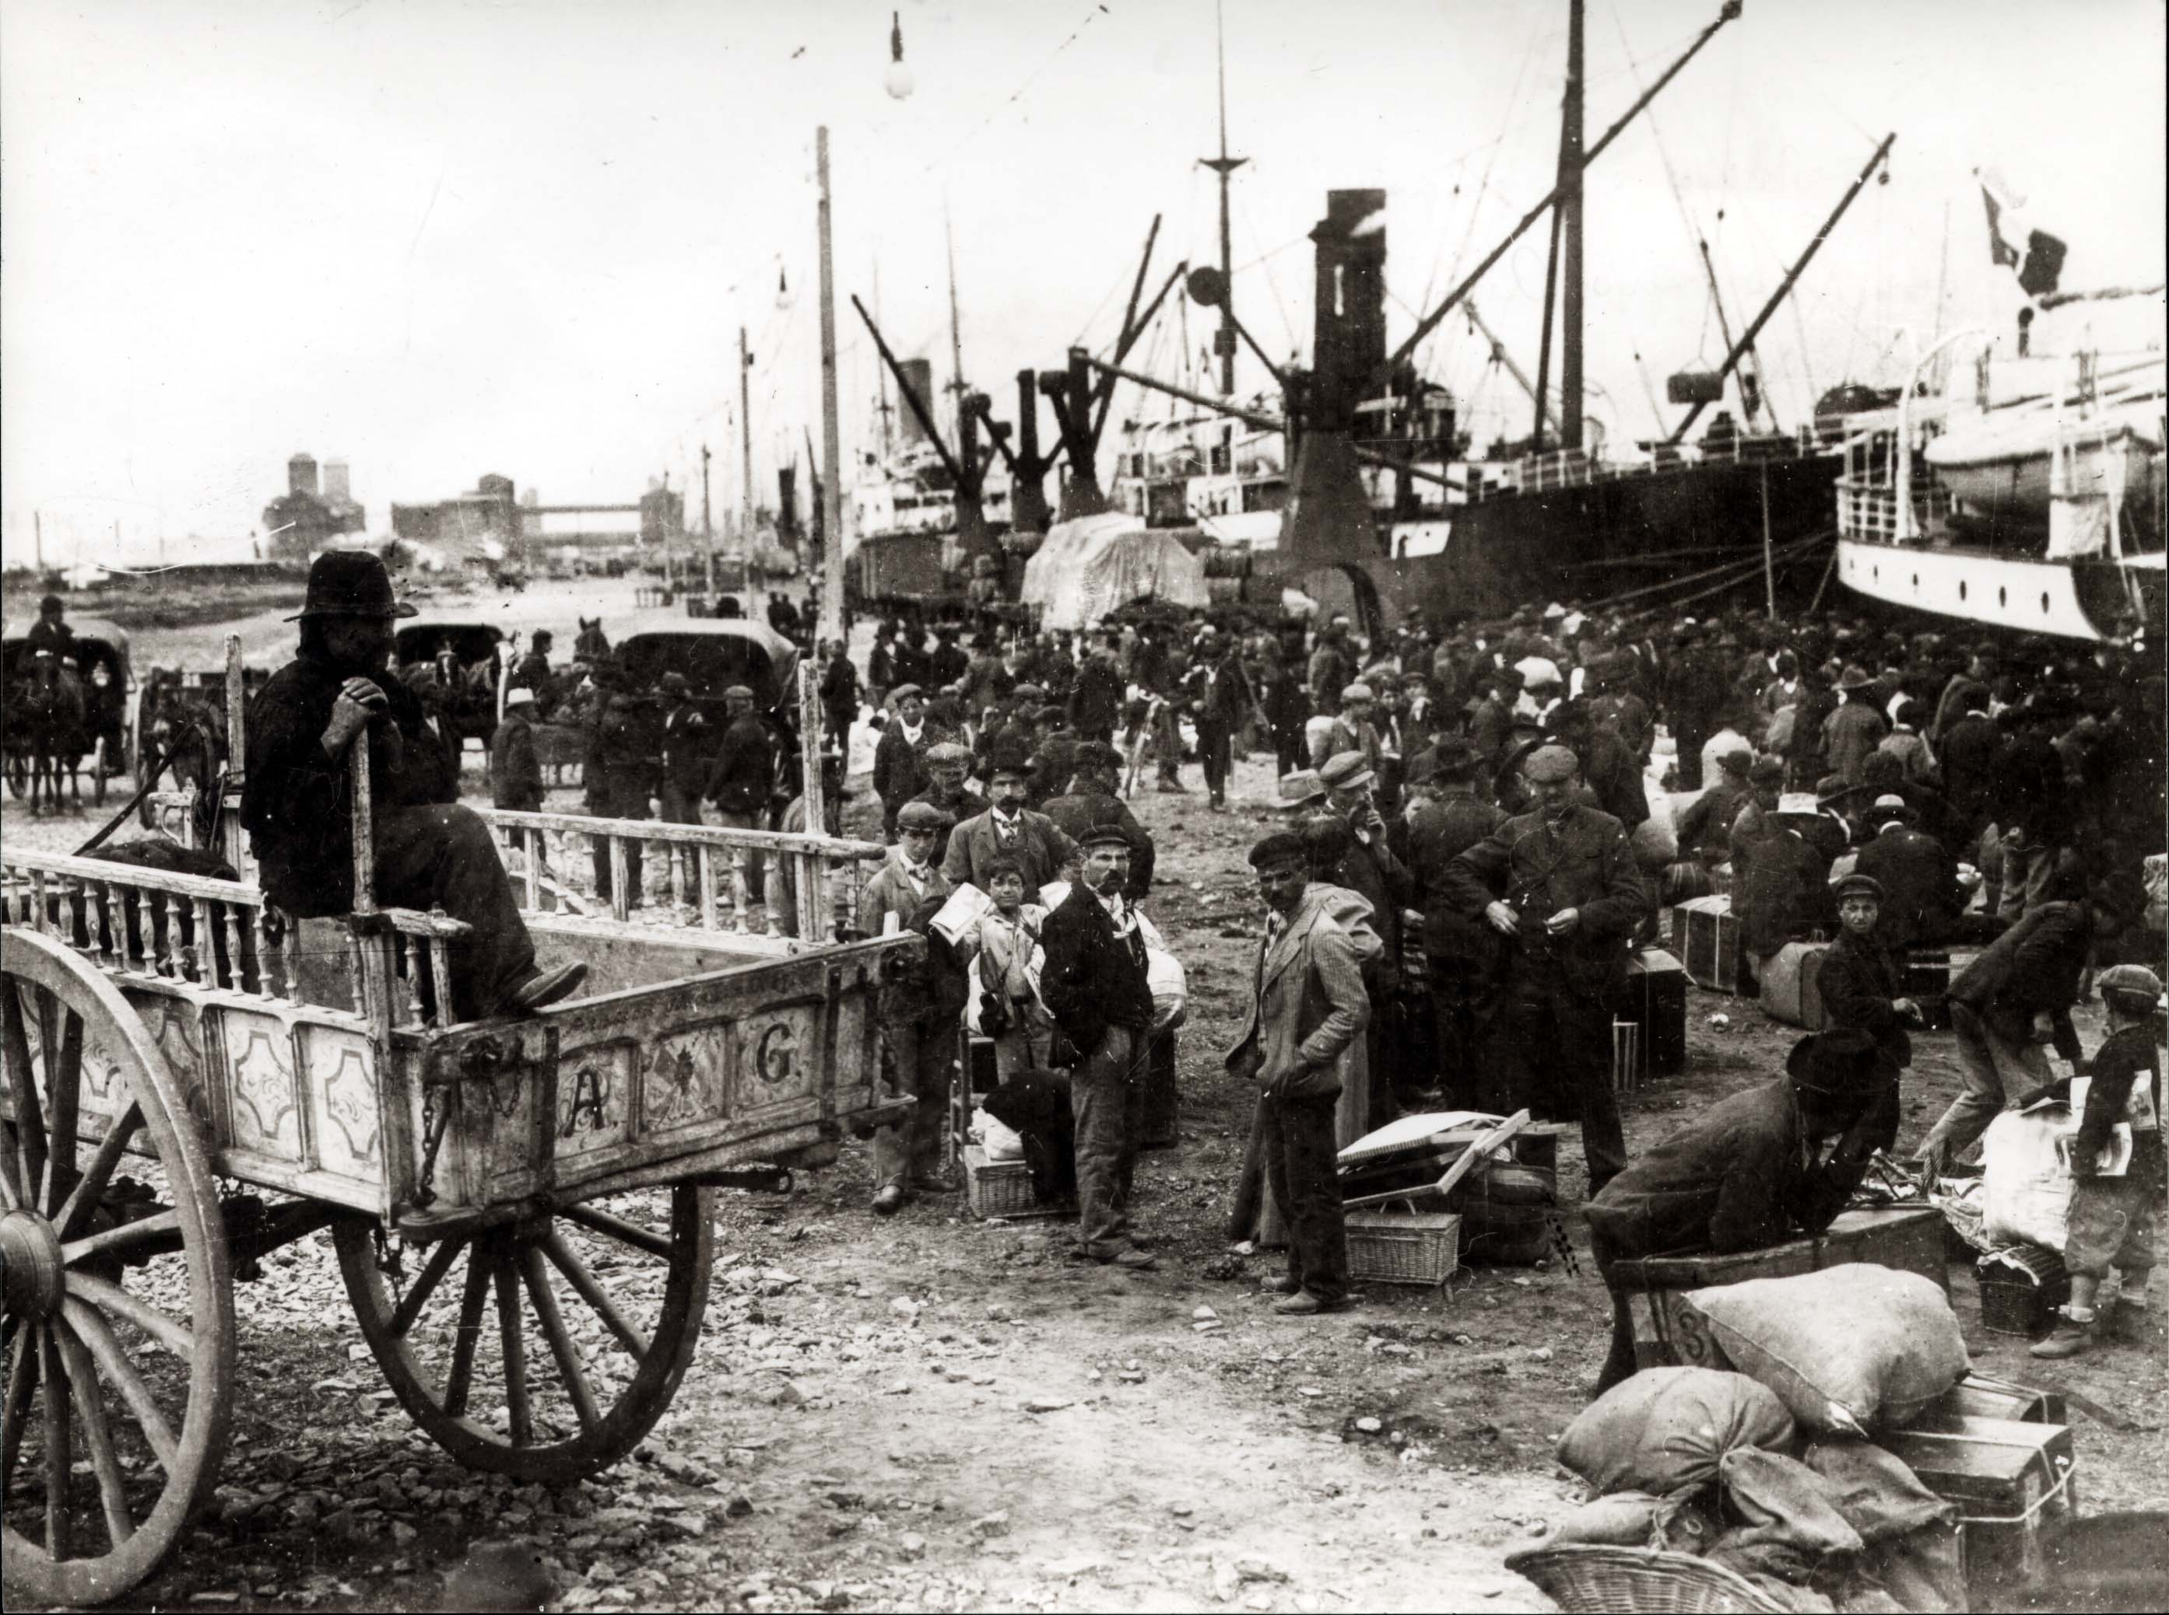

Slide 35
The law launched in 1876 by the Argentine government on colonization and immigration led many Italians to move for a better condition of life in Argentina.
The law provided for the national territories to be divided into batches of forty thousand acres for urban and suburban settlements, offering both the possibility of free land assignments and payable at very low prices ..

Slide 36
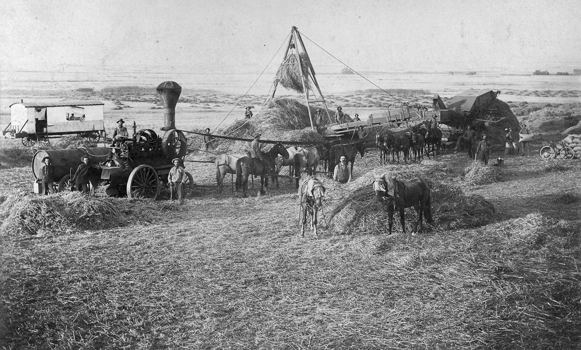

Slide 37
For the purchasers the only obligations were those of the residence and the cultivation of the land; The preference for peasant origins was easily overcome, as almost all agricultural workers in the South of Italy were then looking for work.

Slide 38
Video:
Migration to Argentina

Slide 39
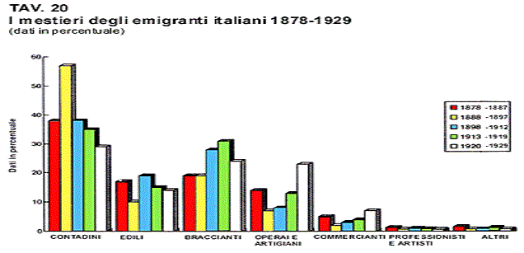

Slide 40
ITALIAN EMIGRATION 1948 1970
4 million italian peoples left their country to find a job in Switzerland, France, Germany, Belgium, ecc

Slide 41
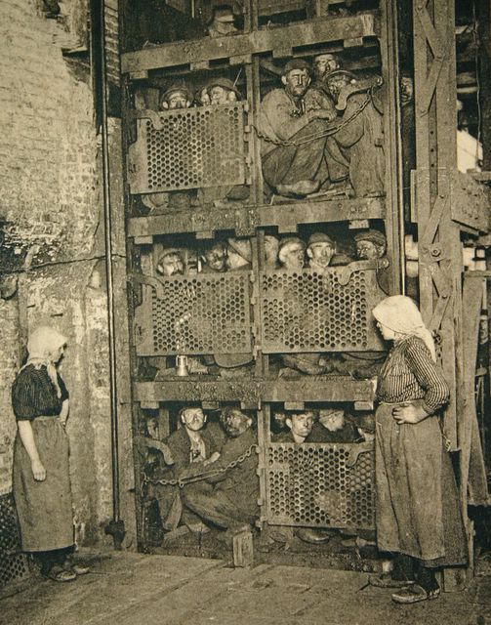

Slide 42
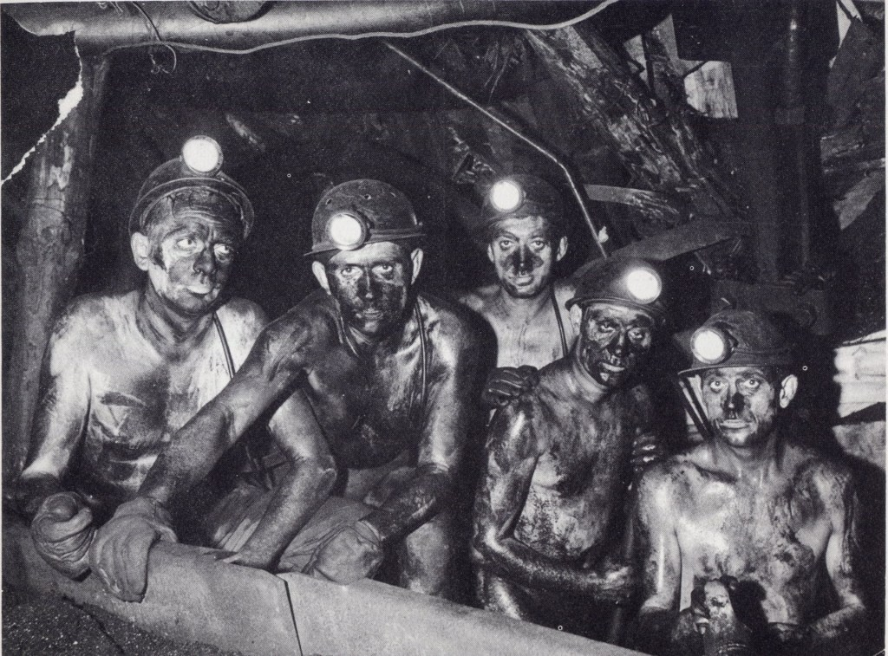

Slide 43
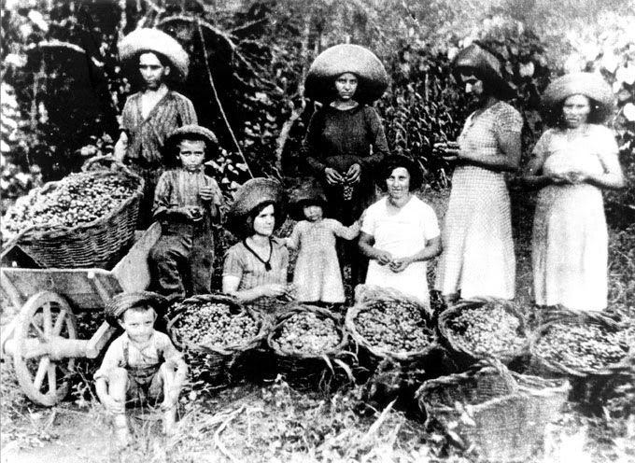

Slide 44
Video:
Australian Migration:
The Italian experience

Slide 45
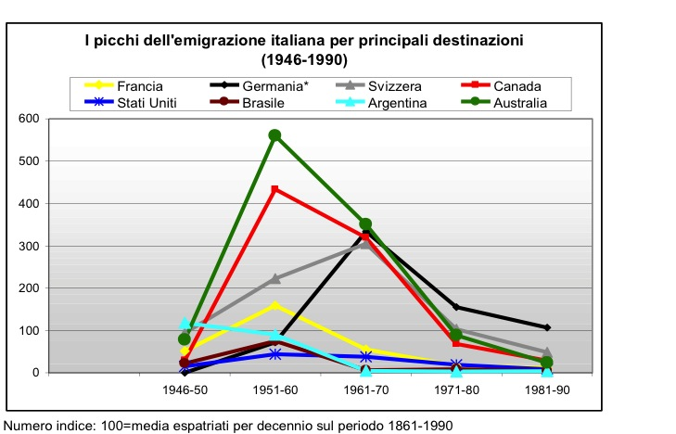

Slide 46
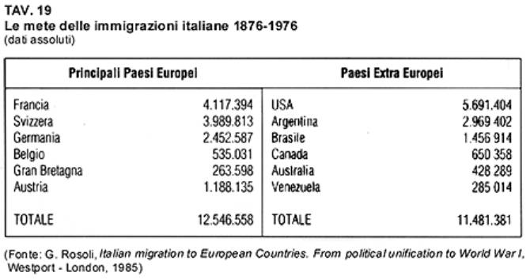

Slide 47
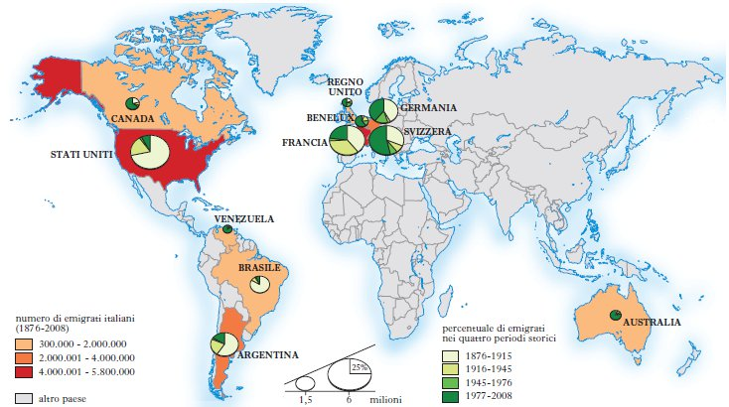

Slide 48
