Slide 1
Racism and Xenophobia
3B Tallini Formia

Slide 2
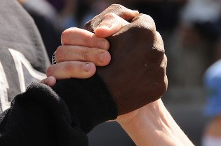

Slide 3
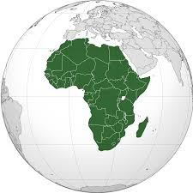
Their blood is the same as yours
We are afraid of the Other, but it's time to change, to live together

Slide 4
Racism and Xenophobia are strong causes of conflict and in the past they were risen by violent clashes among groups

Slide 5
We all should and can do something. As a matter of facts the tragic events of the past and the recent phenomena of racism are more effectively fought with new and concrete strategies.

Slide 6
Racism

Slide 7
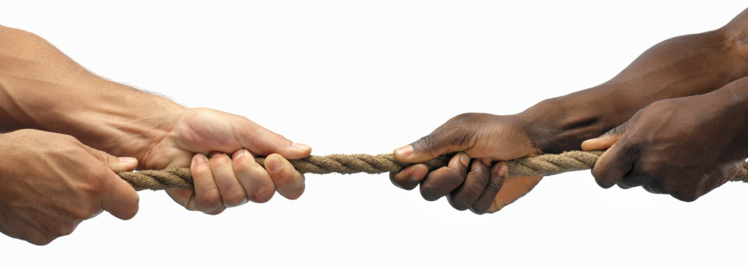

Slide 8
Racism
Everybody knows Racism is one of the worst things we have in the world because it separates people. We may look different from the outside but we are actually almost the same.

Slide 9
Racism
I believe that an effective way to fight racism or stereotypes is to joke about them.
joking even about something serious may help to make it less important and in that case words may sound less heavy. Racism is just the result of anger created to insult people who are different from us without a reason. If you see it as a joke sooner or later people will be tired of offending without a reason.

Slide 10
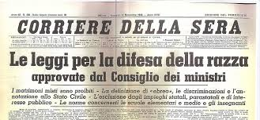
Racism in Italy
Racism in Italy is a historical phenomenon, certainly complex, difficult to define in just one way. It may have its roots in the past, but there is no evidence of its continuity or of an ideological link between the various phenomena at different times

Slide 11
How to fight racism at schools
Racism can be a very big problem especially at school. As a student, you may have to clash with other people who make offensive comments about your ethnicity. However one should be aware that these comments have no value. Even scientifically the concept of ethnicity is just a social construction

Slide 12
How to fight racism at schools
If someone makes a racist comment, you should point out that ethnicities do not determine the kind of person you are or your future because you are talented despite the "limits" of your ethnicity

Slide 13
Violent racist acts
In Italy there were some attacks to different ethnicities : violent crowds attacked a ROM community in Naples in May 2008, in January 2010 to Rosarno, a town in Calabria, a group fought against seasonal immigrated workers,. In September 2008 after a small theft a barman kills Abdul Guiebre in the street. He was an Italian who was born in Burkina Faso.

Slide 14
These racially-motivated crimes occur in a political climate that identifies immigrants with Rom and Sinti communities (many of them are Italian citizens) and contributes to create a climate of intolerance in a country that has seen an exponential increase Of immigration, especially in the last ten years.

Slide 15
Football and Racism
In January 2013 during a friendly match between Milan and Pro Sexton, Kevin Prince Boateng, a Ghanaian player, takes the ball in his hands and leaves the field accompanied by the team due to the racist choirs coming from the tribune.

Slide 16
Football and Racism
On April 28th , 2014 in a championship match between Barcelona and Villareal, the Brazilian player Dani Alves was going to beat a corner kick when a banana was thrown at him by racist fans. He replied in a funny but significant way : he took it from the ground and ate it on the spot.

Slide 17
“It is often easier to become outraged by injustice half a world away than by oppression and discrimination half a block from home.”
Carl T. Rowan

Slide 18
…It doesn’t matter if you are White, Yellow, Red, Black .
We are all the same, all with a single thought
That there is no diversity
Because we are all brothers: this is the truth ...
Quotation from an Italian child in “Il Mattino”

Slide 19
Xenophobia

Slide 21
Xenophobia
Xenophobia, literally "fear of the alien", is an attitude of profound hostility to foreigners and to all that is foreign to one’s own civilization. Often this attitude is confused with racism, which also leads to hatred for people who belong to other cultures

Slide 22
Xenofobia
Xenophobics avoid all the places where they can meet strangers. If this happens, a strong discomfort and a growing state of anxiety may appear

Slide 23
Xenofobia
Racism generally accompanies xenophobia. However, in most cases racism has nothing to do with a real phobia.

Slide 24
Xenofobia
This genre of phobia begin when some different cultures and ethnical groups meet themselves and have to cohabit in the same geographical territory. In not so rare cases people tend to fear or distrust those who are not like themselves.

Slide 25
Xenofobia
Xenophobia has increased with the growth of various fundamentalist religious movements and with the birth of extremist political movements.

Slide 26
Xenofobia
According to us, Xenophobia is not right because all people are equal and people’s rights and dignity go beyond our skin color, eye color or living conditions. Before committing racist acts to people who are physically different from us, we have to think what is our problem with them.

Slide 27
How to sort it out?

Slide 28
It is necessary to inform and educate public opinion, from younger generations, so that they could be a means of promoting a new era, a new global society in which human rights are respected without distinction of race, sex, or religion.

Slide 29
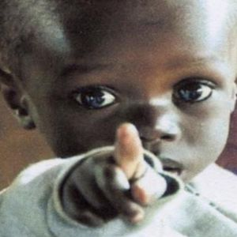

Slide 30
...

Slide 31
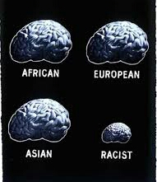
There are no different men in the world
«If you raise a wall think about what's left out» I.Calvino

