Slide 1
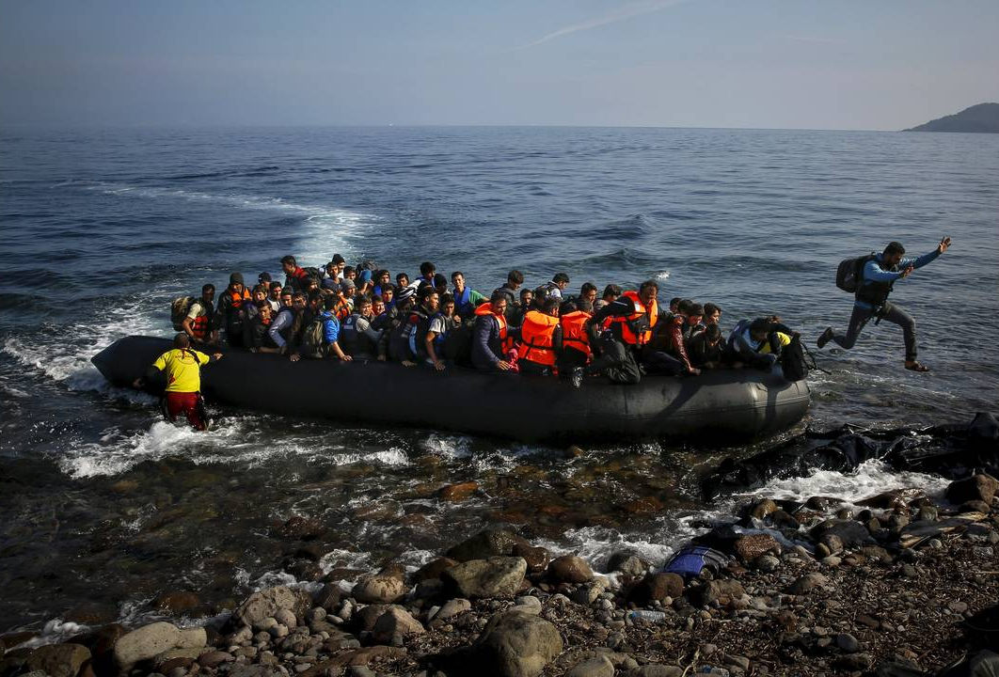
How Greece handled the refugee crisis

Slide 2
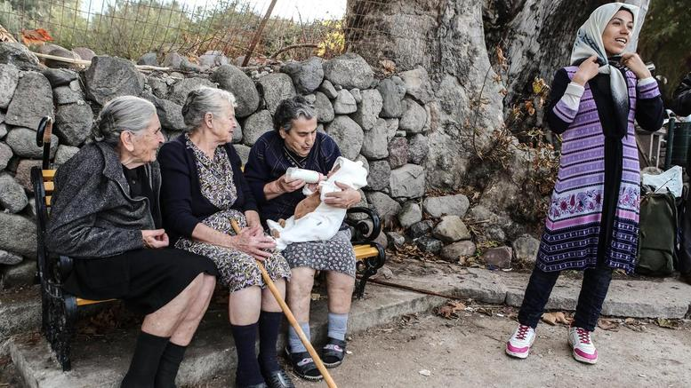
UNCHR 2015 report
More than 851.319 refugees, requesting asylum and immigrants crossed the sea to reach the Aegean islands
More than 610 people drowned
They were initially welcomed on the islands by activists, volunteers, NGO (Non Governmental Organizations) and the UNHCR (United Nations High Commissioner for Refugees aka UN Refugee Agency)

Slide 3
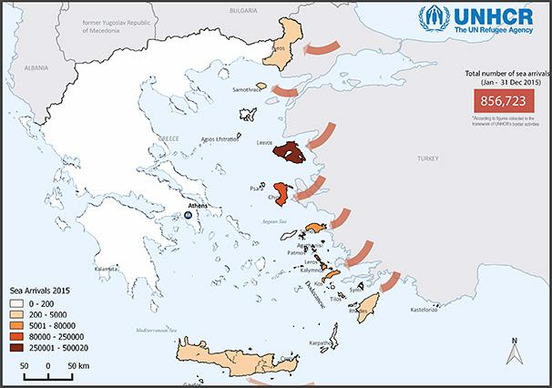
Bad programming, inefficient use of the money given by the European Union and the financial crisis in Greece led the Greek government to face this crisis with a distraught
In mid October, the Greek authorities established a pilot plan for the screening of the new arrivals by the European organisation for the management of external borders (Frontex) and the Greek Police
The islands that receive the highest number of refugee currents are: Lesbos, Chios, Samos, Kos, Leros and Agathonisi

Slide 4
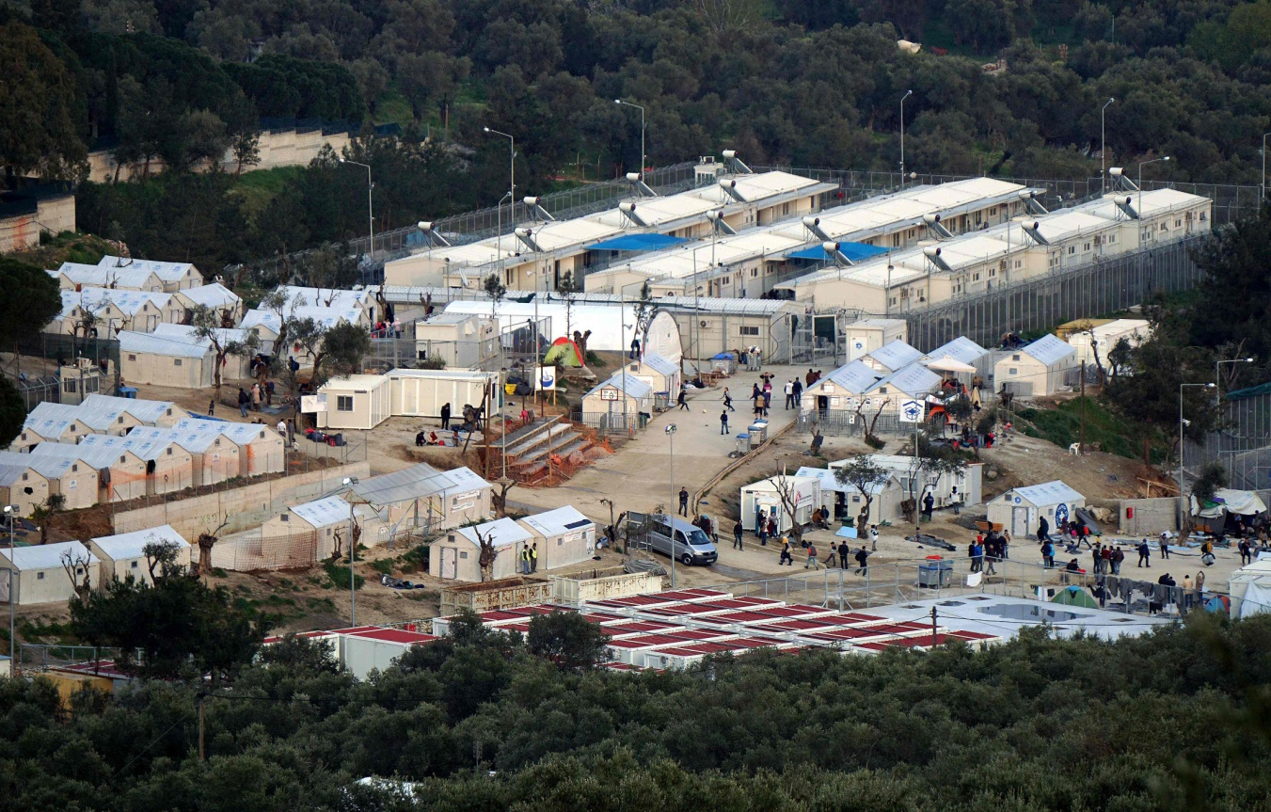
Creation of refugee camps on the islands and in Athens
Creation of hospitality structures with better living conditions
Relocation
... A picture shows a view of the Moria camp for migrants and refugees on the Greek island Lesbos

Slide 5
What is prescribed in the international scripts about the immigration framework
The European Union immigration policy relates to the relocation of immigration populations, their inclusion, and also the offering of asylum.
This policy is based on the principles of solidarity and trust, and also the allotting of responsibilities amongst the members-countries of the EU.

Slide 6
Immigration flow to Greece from the beginning of 2015 till mid 2016 According to the International Organisation for Migration (IOM), Greek Office, since the beginning of January 2015 till June 2016 the total amount of refugees that crossed Greece is 1.015.559 refugees. .

Slide 7
Refugees who arrived in Greece from Syria, Afghanistan, Iraq
2015 | 857.363
2016 | 158.196
Ιn the beginning of 2017 | 2.724

Slide 8
January 2017
62.784 refugees and migrants | are living in formal and informal camps, have found their own home or they are living in NGO hosting centers.
15.405 people of them | are living in camps in Greek islands.

Slide 9
Germany, France, Spain, Poland, the Netherlands, Romania, Belgium, Sweden and Portugal, and other Member States of E.U. agreed to relocate the refugees from Greece and Italy

Slide 10
In September 2015, EU Member States agreed to relocate 160.000 refugees from Greece and Italy.
Unfortunately, only 1.145 refugees have been relocated.
The number of refugees who live in Greece and have the right to relocate is about 35.000-40.000.

Slide 11
European states have accepted less than 30 % of the asylum seekers that they pledged to relocate back in September 2015
With few exceptions, the majority of European states have not seriously engaged with the scheme. They have failed to offer places according to their commitments or have accepted asylum seekers at a very slow pace
Among the worst offenders are Poland and Hungary, both of which have refused to accept a single asylum-seeker from Italy and Greece.
Norway and Lichtenstein opted in to the scheme voluntarily, and have both fulfilled their commitments to relocate 1500 and 10 respectively.
International amnesty report 26 /9/2017

Slide 12
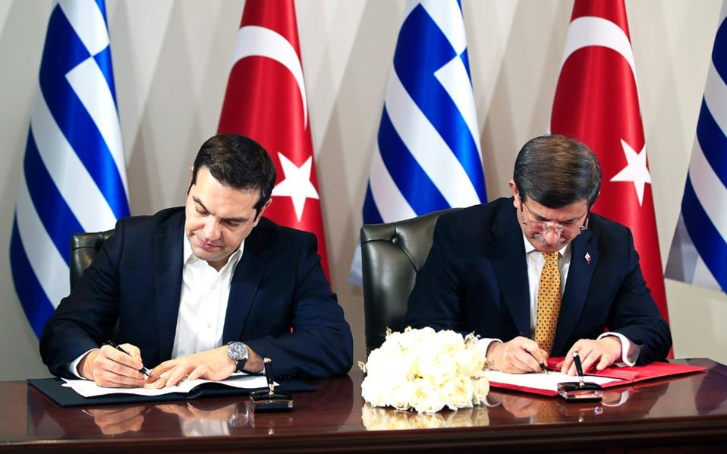
March 2016 The agreement between EU-Turkey
Turkey and the EU have decided to end the illegitimate migration from Turkey to the Greek islands.

Slide 13
EU- Turkey Agreement
All refugees going through the Turkish coastline to the Greek islands will return to Turkey, as well as all those whose asylum application has been denied.
Further on, according to the criteria of the UN, there will be a correspondence for every Syrian returning to Turkey from the Greek islands to a Syrian instated in the EU, giving priority to the immigrants that haven’t tried to enter Greece illegally.

Slide 14
Activation of the “Voluntary Humanitarian Admission Scheme” program, were the members of the EU can participate in a voluntary base,
There’s a provision for the acceleration of issuing visas for Turks for countries of the EU
Disbursement of 3 bil Euros, as a benefit to the immigrating population, till the end of March

Slide 15
The up to date acts of the Greek government
The management of over a million refugees “with increasing care and dignity”
The creation initially, of 40000 hospitality places for the management of 60000 people that have been trapped in the country “after the illegal shutting of the borders by the neighbouring countries” and secondary the sheltering of asylum seekers, in apartments (House renting, following the project <<Temporary Housing of Refugees>> financed by the United Nations High Commissioner for Refugees).

Slide 16
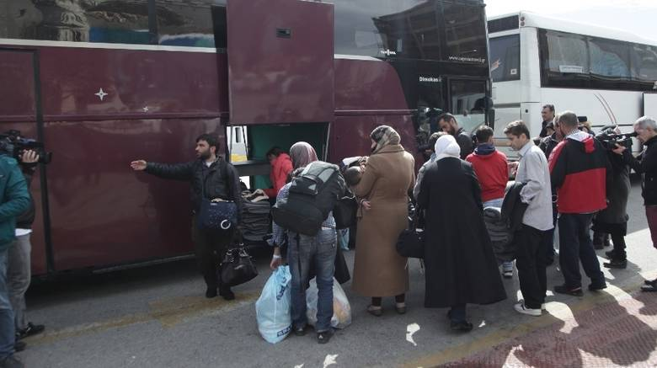
The peaceful – non violent transport of refugees and immigrants from camps to the hospitality structures, where housing, food, nursing and psychosocial support is offered

Slide 17
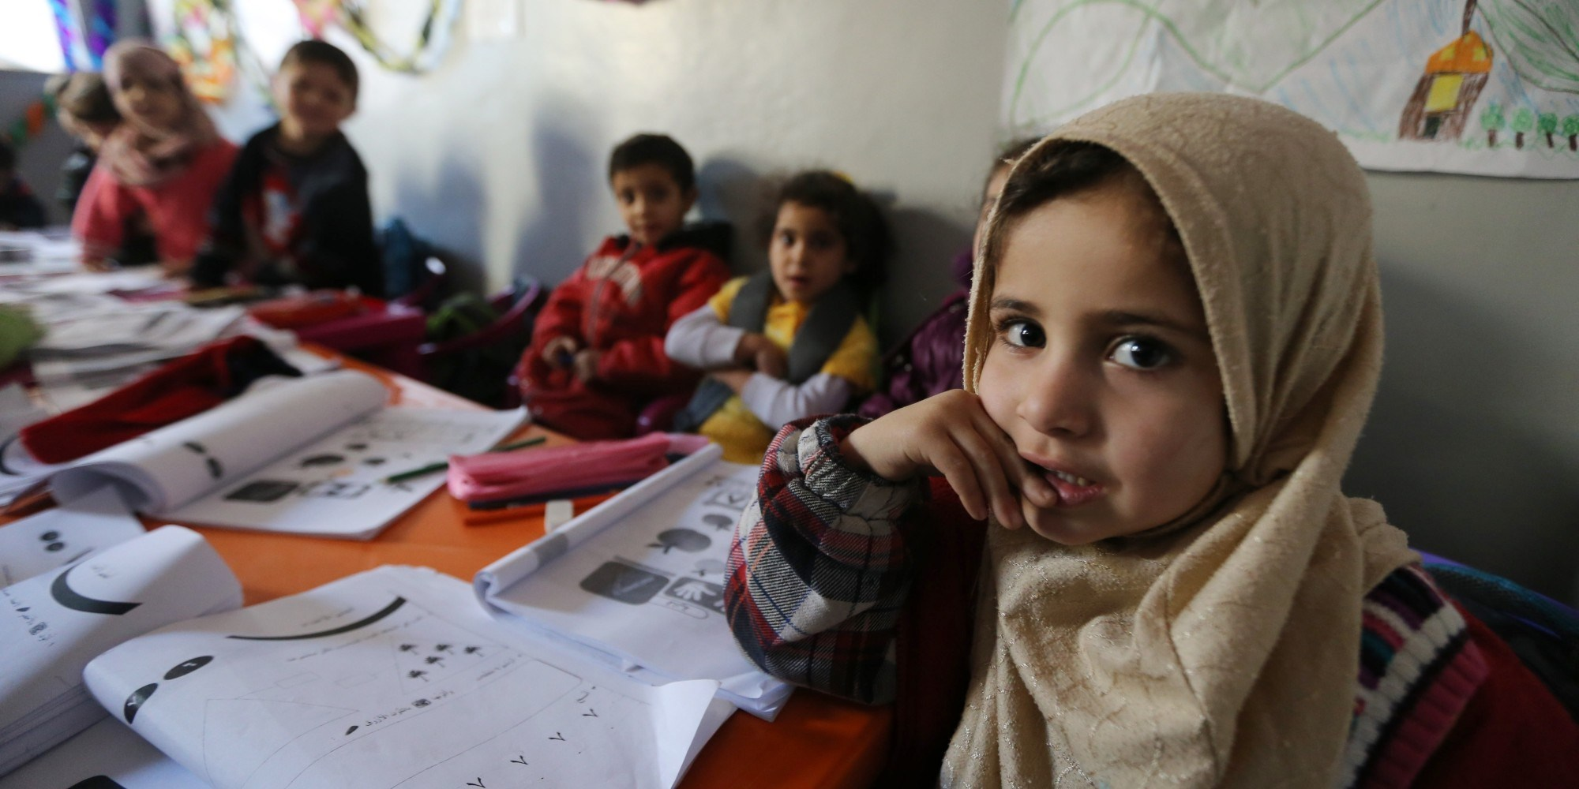
The gradual introduction of kids to education and acts of culture and athletics (the young refugees that study in Greek schools are about 2500 for the year 2016-17 in 94 schools).

Slide 18
The government’s policy is to keep trying so that all rights that the refugees are entitled to, are offered, in conditions of dignity and humanity.
Refugees should be treated equally with access to health, education, work and life.

Slide 19
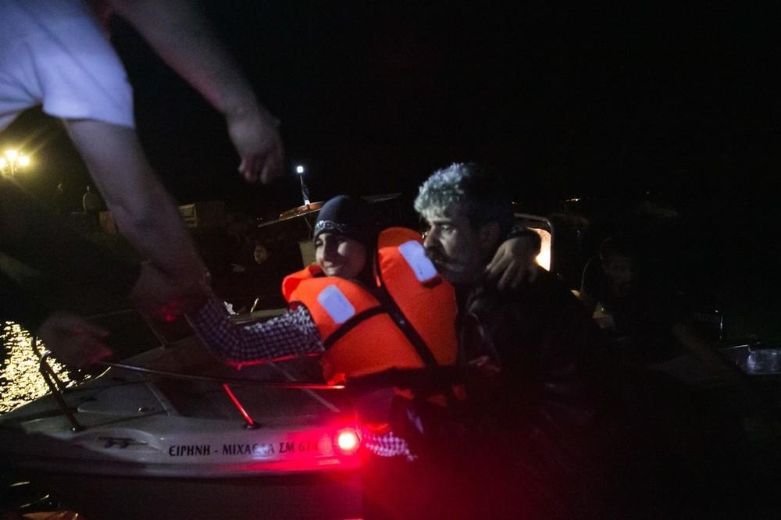
Us Greeks with the solidarity we have shown up to now, we need to continue to accept the refugees as part of our society and help them integrate.

Slide 20
What is desired, is not to let the refugee lose his identity, his values and way of leaving. It is to move forward, in a way that he keeps his identity, but also to be able to adapt to the new circumstances

