Slide 1
We must understand that we are no longer living an emergency situation now, but
we are facing a structural phenomenon.
Every minute - according to Unhcr, United Nations High Commission for Refugees – due to wars, violence, and serious violations of human rights - a total of 24 people are forced to flee to avoid an unsustainable situation.

Slide 2
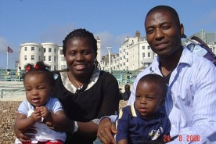
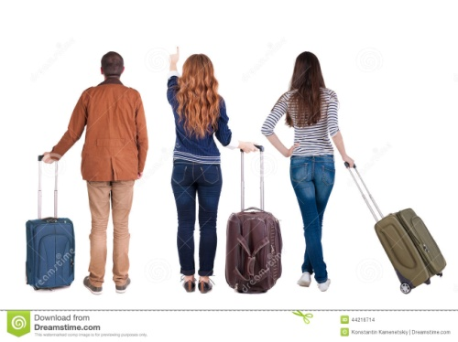
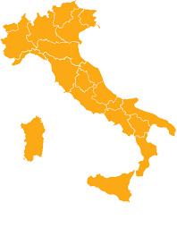
FIGURES TO UNDERSTAND THE PHENOMENON
1.500.000 persons
5.202.000 persons
5.126.523 persons

Slide 3
The Immigration Statistics Dossier 2016 *, by the IDOS Study and Research Center, allows us to have a precise picture of immigration in Italy and to be able to overcome so many prejudices and commonplaces.
First, Italians should know that:
Italian citizens residing abroad are 5.202.000
Foreign citizens residing in Italy are 5.026.153.
Foreigners actually in Italy, and not only the residents, registered by ISTAT, are 5.498.000
In order to complete the picture, those who have so far acquired Italian citizenship (1.150.000) should be added.

Slide 4
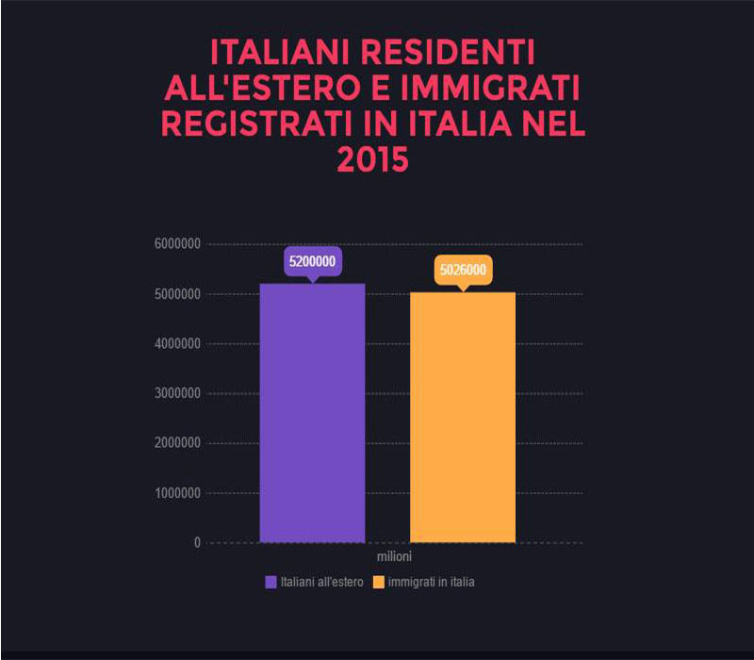

Slide 6
The labour market
2,359,000 are the foreign employees in Italy, amounting to 10.5% of the employed.
Unemployed (456,000, 15%),
Foreign entrepreneurs in Italy: 550.000 (9% of total companies),
To confirm the dynamism, vitality and importance of the foreign component there are also data on their social security contributions (€ 10 billion) and taxes (for an estimated 17 billion against a return on public spending for them quantified in 14 , 7 billion euros).

Slide 8
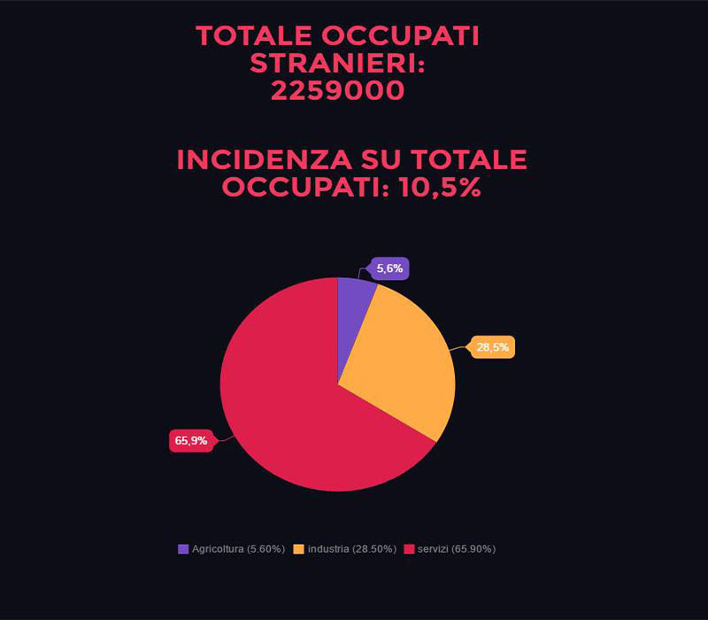
Industry;
Agriculture;
Services.

Slide 9
In 2015, landings in the southern coasts of Europe involved more than one million people, including 850,000 in Greece and 150,000 in Italy.
Migrants 2017: the numbers in Italy
According to Unhcr data, between January 1 and April 21, 2017, 36,637 people landed in Italy. This number is much higher than the one referring to the same period of 2016, when 18,784 people (+ 29%) arrived.
In March 2017, 10802 migrants arrived in Italy by sea, 12% more than last year, five times more than March 2015.

Slide 10
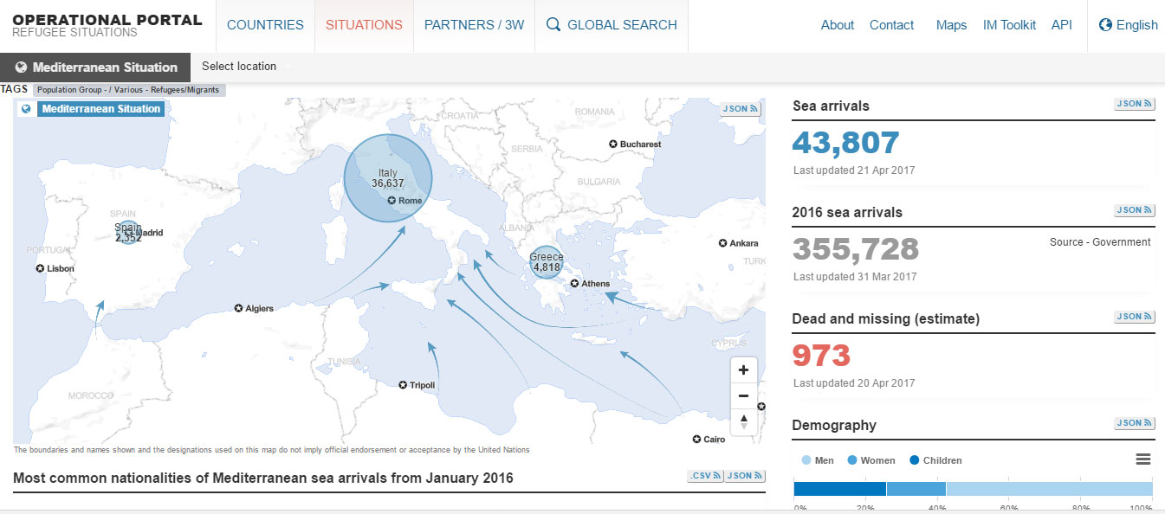

Slide 11
There is some news about the countries of origin (data updated on February 28, 2017). The most represented are Guinea (15% arrivals), Nigeria (14%) and Bangladesh (12%). Following are Gambia (10%), Ivory Coast and Senegal (9%), Morocco (8%).
To arrive in Italy are mostly men (71%), with a significant proportion of unaccompanied minors (16% of arrivals).

Slide 14
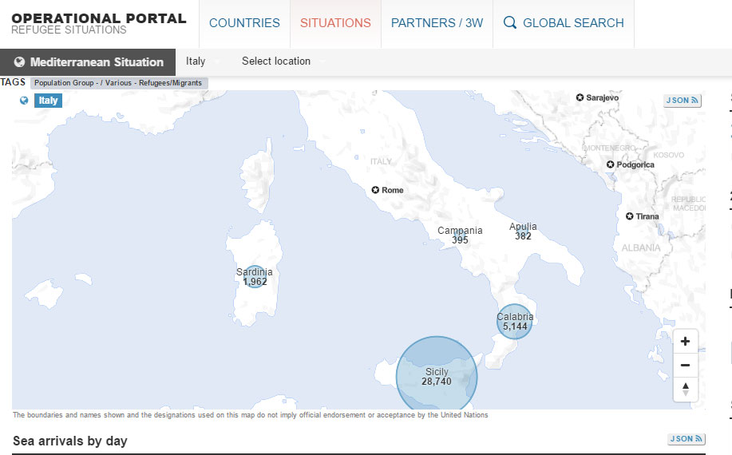
Most of the landings are in Sicily (84%) but there are arrivals by sea also in Calabria (13%) and Sardinia (3%).

Slide 15
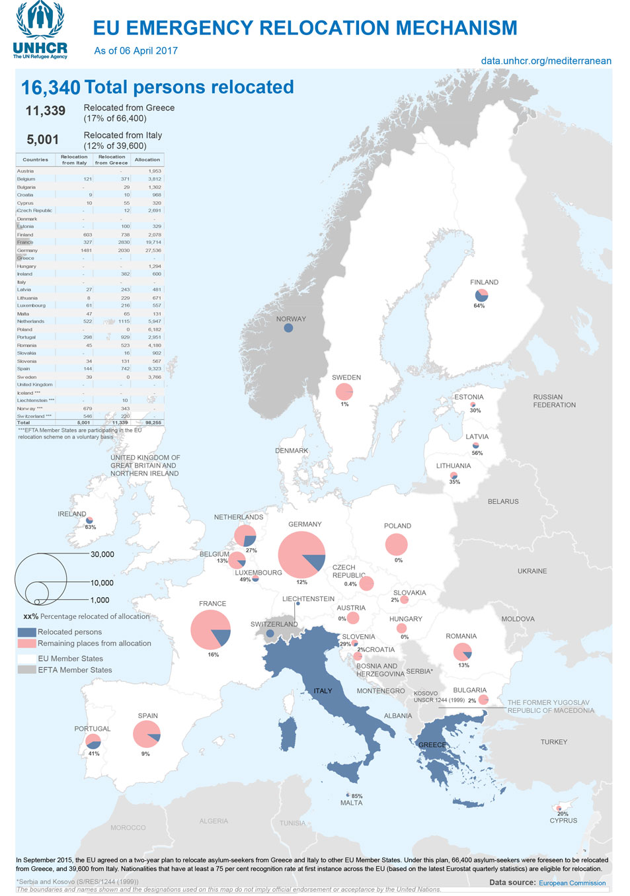
Europe meanwhile has raised walls, while the promise to relocate asylum seekers, in order to relieve pressure on countries such as Greece, Turkey and Italy, has not been maintained (only a thousand transfers from Italy).

Slide 16
WHAT TO DO?
One of the most widespread commonplaces that the Immigration Dossier helps to overcome is related to the costs of foreigners in our own place:
They pay the State 16.9 billion euros (social security contributions and taxes) that is more than what they receive, 14.7 billion.

Slide 17
16,9 billion€€€€€
14. 7 billion €€€€€

Slide 18
Video:
SALVINI

Slide 19
Immigrants: 35 euros per day plus meals and lodging? No, it's a hoax!
We think that more than once you have come across posts where it is written: “an immigrant in Italy besides having food and free accommodation receives also 35 euros a day, while the Italians can hardly make the ends meet" .
But the news is false.

Slide 20
However, this news has something true in it.
In fact, for every refugee in Italy, the state spends about € 35 a day, much of which is funded by the European Union. However, the money is not directly given to the immigrant, but it is used to finance the expenses incurred by the cooperatives involved in their reception.
So in those 35 € per day are included the cost of the meal and accommodation, but also of medical expenses. A small fee also covers work placement programs.

Slide 21
HOW MUCH MONEY DOES AN IMMIGRANT RECEIVE A DAY?
A very small sum, therefore, remains to the immigrant. It is the so-called "pocket money", the amount they have to finance their daily needs, such as phone calls to call home or just to buy a bottle of water at the bar.
The pocket money is usually € 2.50 per day, so it is about € 80 a month, but in some regions it is reduced to € 2.

Slide 22
Africa is present in Italy with some important communities, especially from North Africa: the Moroccan community(438,000), the third one after Romania and Albania ,but the first non-European, and the Egyptian community (110,000). Africa represents one fifth of foreign residents (1.037.000, or 20.6%), while it is first among the number of individual entrepreneurs from non-European countries, led by people with Moroccan origin, who are the first ever, since they also precede those originating from China, Romania and Albania.

Slide 23
There are projects, such as INSIDE and PATH, promoted by the Ministry of Labor and Social Policies, the project "Welcome - working for Refugee Integration", implemented in collaboration with UNHCR and Confindustria (The General Confederation of Italian Industry), as well as the Memorandum of Understanding with the Ministry of Interior and the Ministry of Agricultural, Food and Forestry Policies, aiming at fostering joint efforts in the area and synergistic action against a legally and humanly unacceptable phenomenon such as that of “Caporalato” ( labour exploitation).

Slide 24
What should we do?
Promote the integration processes by fostering the learning of the Italian language;
Not speaking the Italian language is the first obstacle to social inclusion and many foreigners, even after a few years of presence in Italy, do not have the proper knowledge of the language.

Slide 25
2) Promote mutual knowledge of the rules of social coexistence.
This integration path must be accompanied by the knowledge of the principles of civic education in Italy, the laws, the practices, customs and traditions of the host country, which must at least be learnt by those who intend to get integrated into a foreign country.

Slide 26
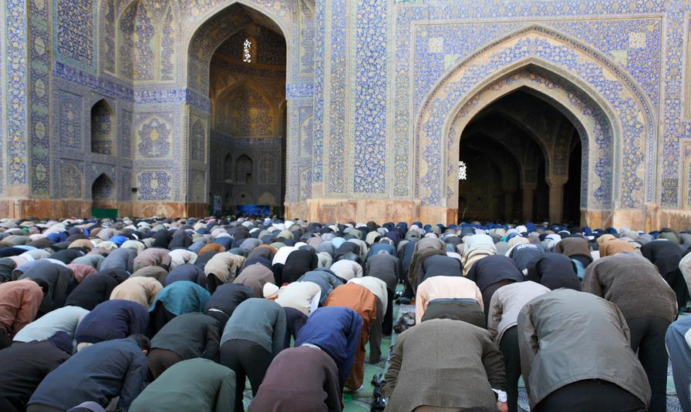
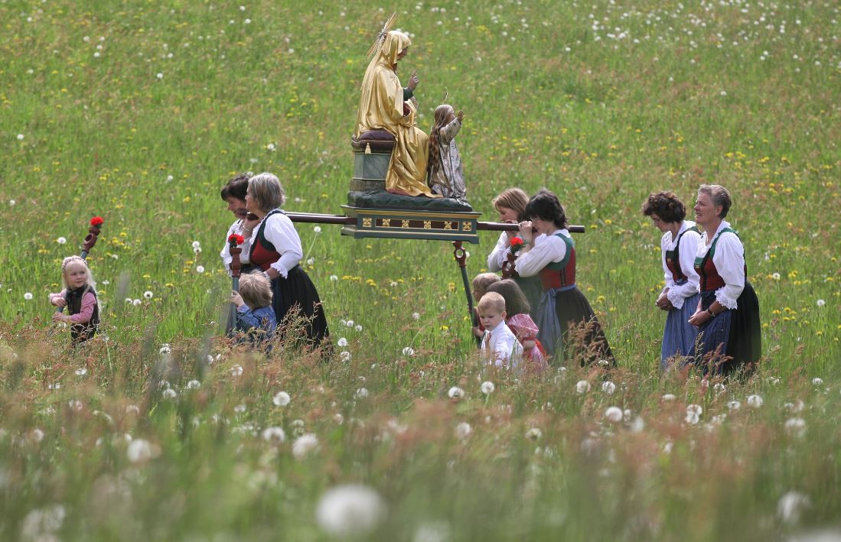
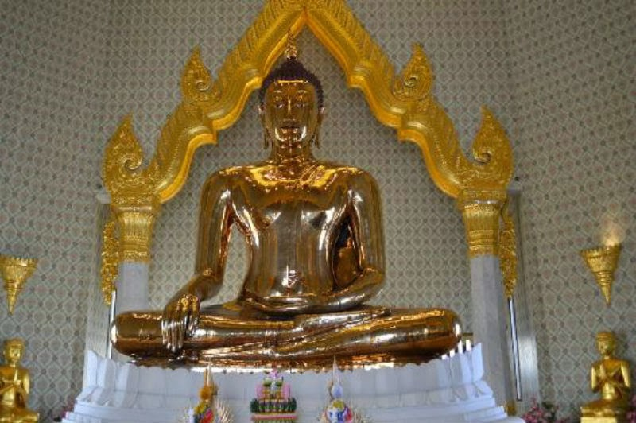
Likewise, the customs, traditions and religious practices of refugees must also be made known.

Slide 27
Production of information material and organization of meetings
addressed to foreign citizens, for the dissemination of the rules of functioning of the local society: from the Constitution to the knowledge of the territory and its social history.

Slide 28
Specific attention should be paid to foreign women
and therefore to how to implement interventions, also to face the possible situations of territorial and / or social isolation of women.

Slide 29
Combating racism / discrimination and promoting legal protection
One cannot underestimate the risks of growing racism and xenophobic subculture in today's multicultural Europe and in the coming years.

Slide 30
Realization of public events aimed at fostering knowledge and socialization
between Italian citizens and citizens of foreign origin.

Slide 31
The purpose of this project is to sow a seed that can arise responsible and respectful behaviors towards all the minorities now present in Italy

